Slide 1
ROLLBALL ASSOCIATION OF ANDHRAPRADESH (SPORTS MANAGEMENT SYSTEM)
TEAM MEMBERS:
R.V.S. TEJA KRISHNA(17MIS7085)
K. KRISNA REVANTH(17MIS7057)
P.H.S ABHIRAM(17MIS7073)
K. VARUN TEJA CHOUDARY(17MIS7156)

Slide 2
OBJECTIVE
To maintain the details of the players who have registered for the competition
The player can register himself in the website with his details and can be able to view the details of the upcoming competitions.
The player will get a mail notification when there is any new competition is going to be held.
The purpose of the project is that to maintain unity in all the player who belong to the andhrapradesh state.

Slide 3
IMPLEMENTATION
This project is developed using PHP framework and the styles are given using the CSS and in the backend, database is connected to MYSQL in xampp server.

Slide 4
COCOMO MODEL
The total source lines of code in the project are 1558LOC=>1.558KLOC i.e., approximately to 2KLOC.
Most of the small to medium sized projects are estimated with Basic COCOMO model.
Since the total KLOC are approximately equal to 2, this is “Organic Mode”

Slide 5
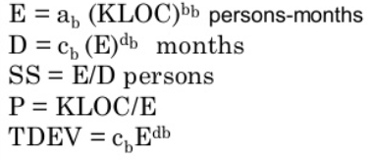
So in the organic mode, the coefficients will be a_{b} ,b_{b} ,c_{b} ,d_{b}
a_{b}=2.4, b_{b}=1.05, c_{b}=2.5 d_{b}=0.38

Slide 6
Effort E= 2.4*(1.558)^{1.05} =3.823
Deployment time D= 2.5*(3.823)^{0.38} =4.1615
Staff Size SS = E/D = 3.823/4.1615 = 0.9186 ~ 1
Productivity P = KLOC/E = 1.558/3.823 = 0.4075
Development time TDEV = 2.5*(3.823)^{0.38} =4.1615

Slide 7
USER INTERFACE

Slide 8
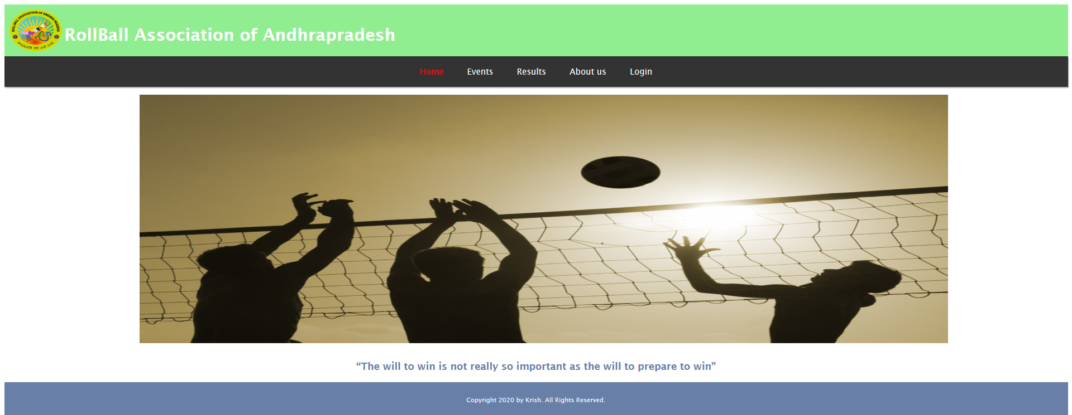
Home page

Slide 9
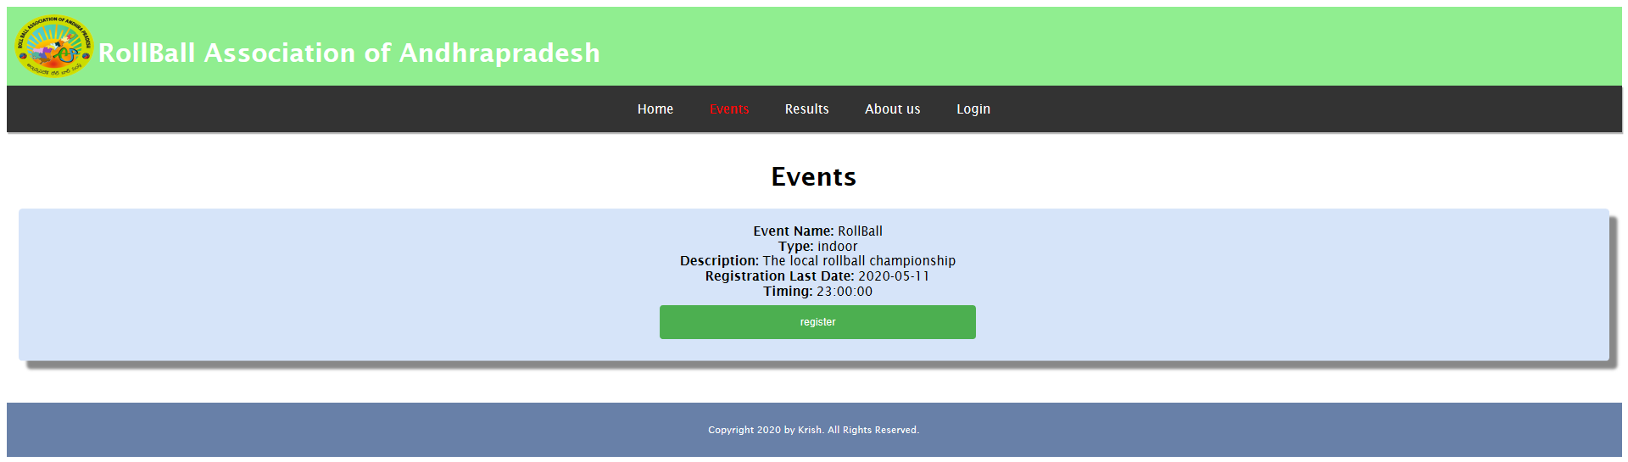
Events

Slide 10
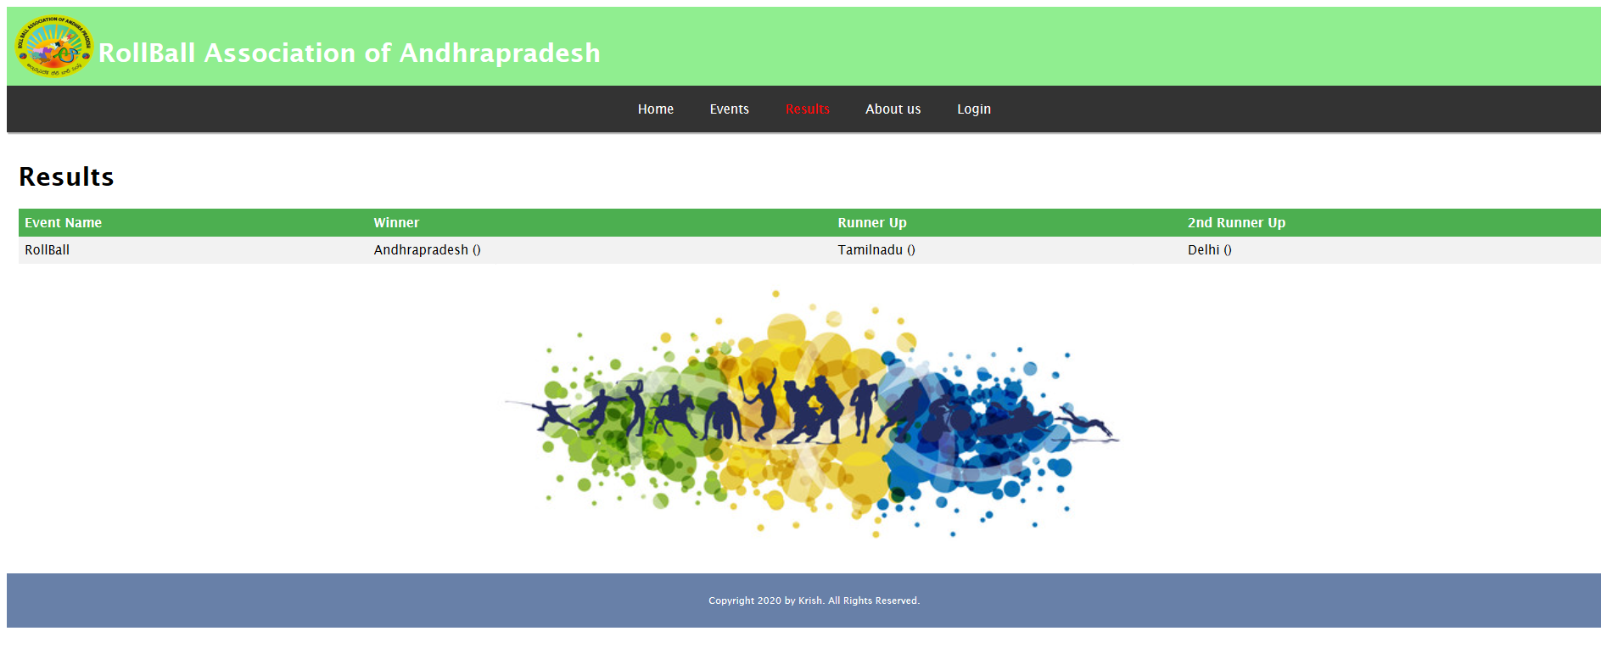
Results

Slide 11
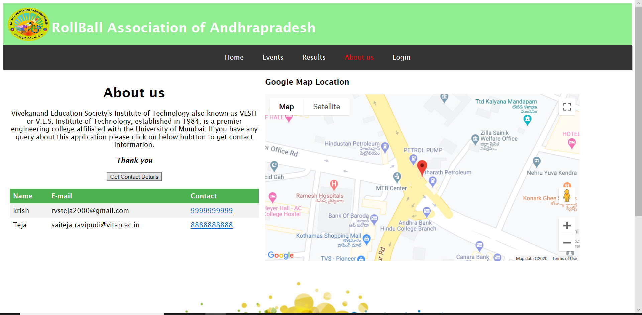
About Us

Slide 12
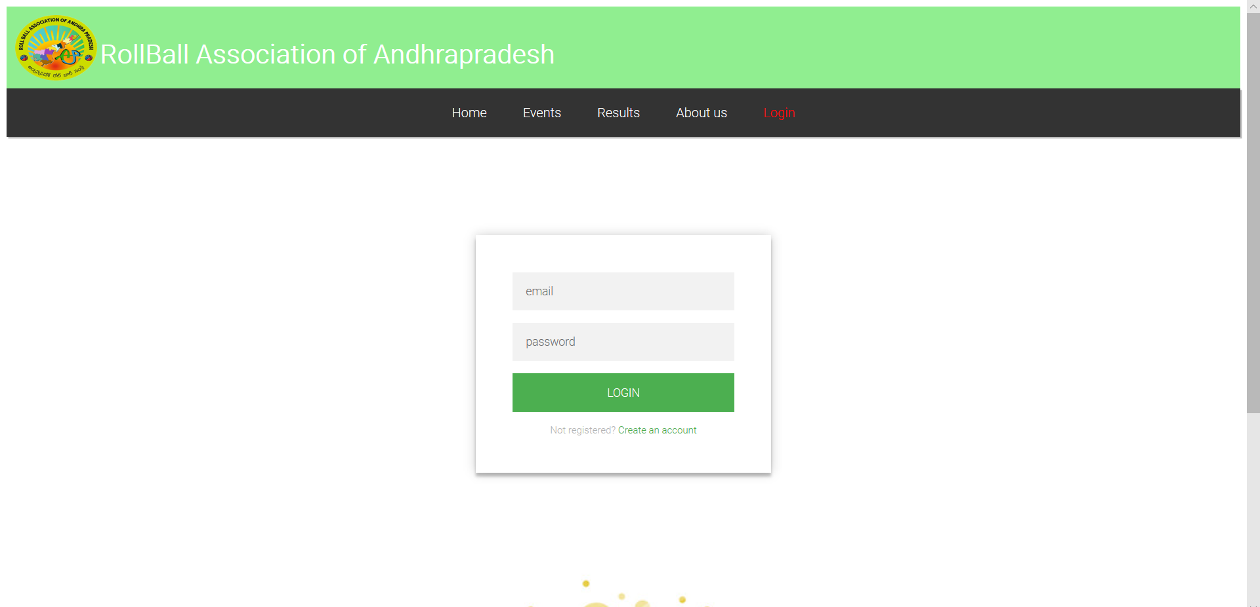
Login

Slide 13
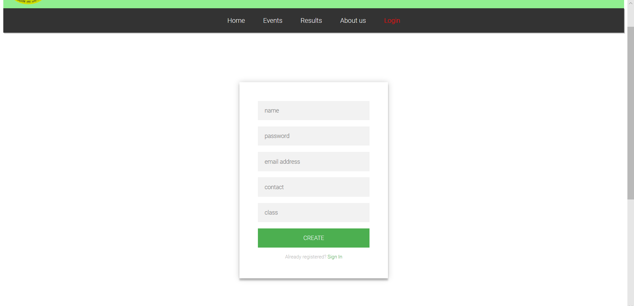
Sign up

Slide 14
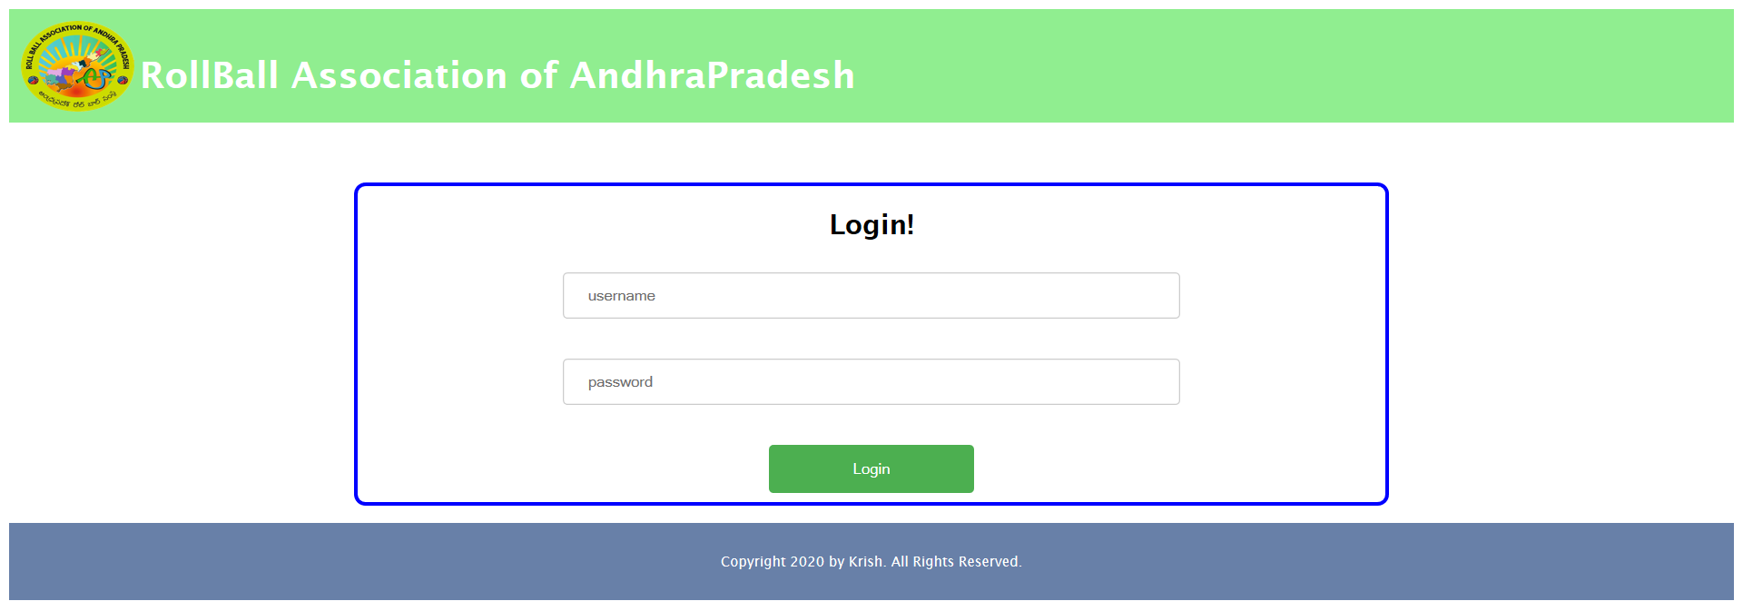
Admin login

Slide 15
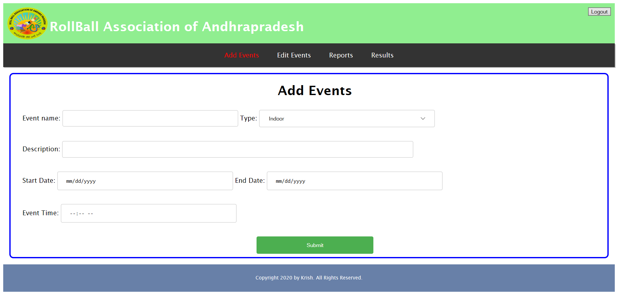
Add Events

Slide 16
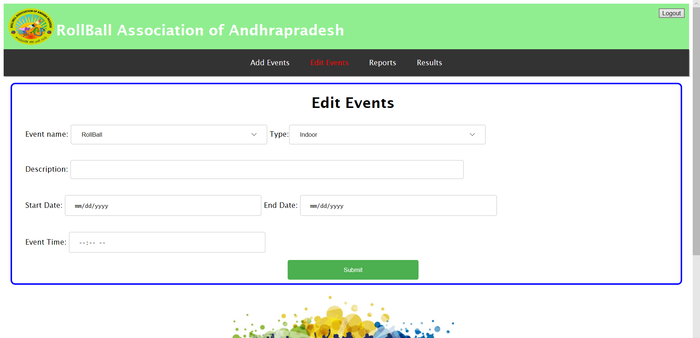
Edit Events

Slide 17
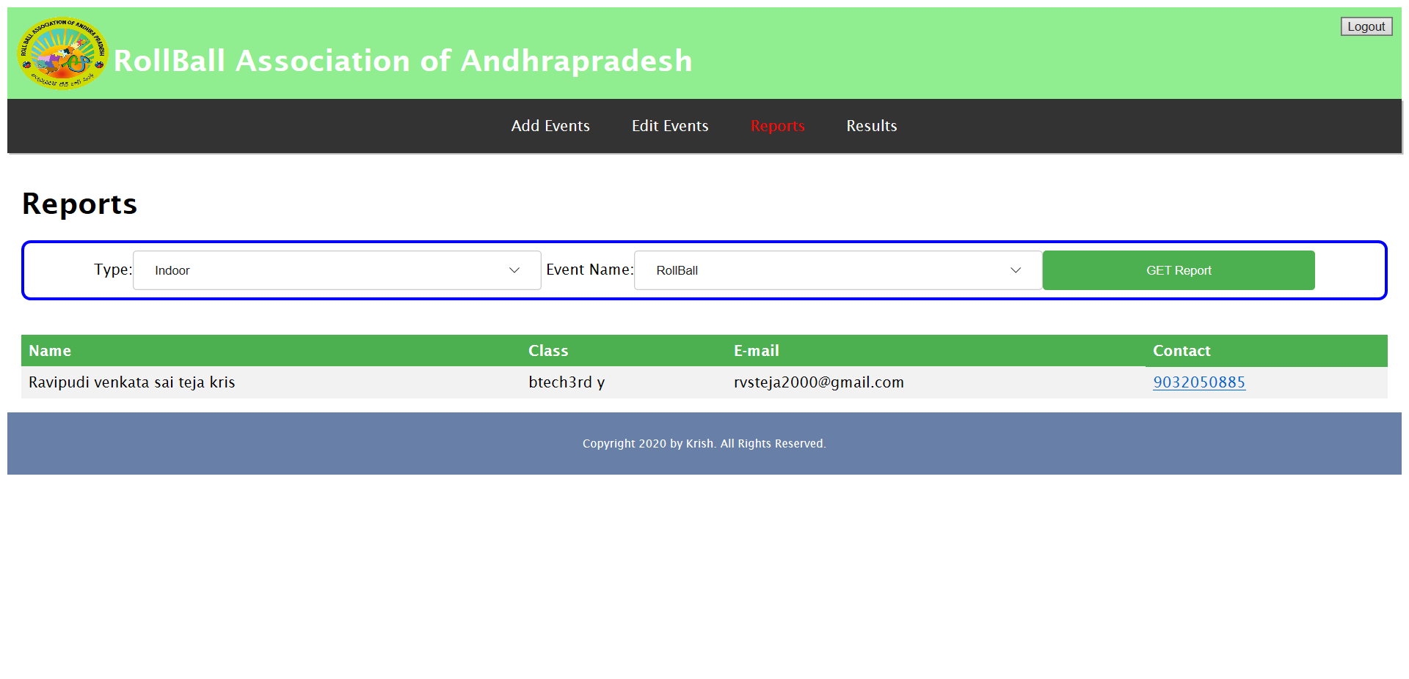
Reports

Slide 18
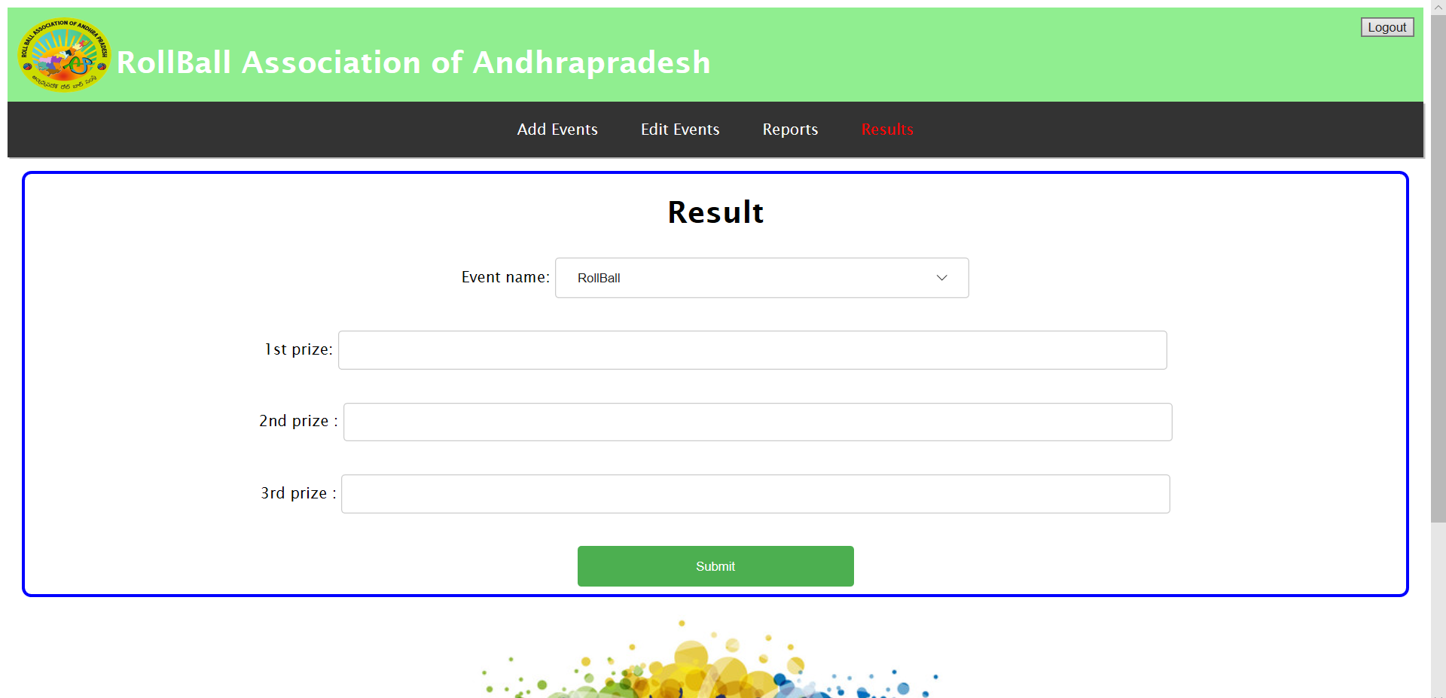
Results

Slide 19
Thank you

